Slide 1
Getting Started with the CDSA and Model-driven Apps

Slide 2
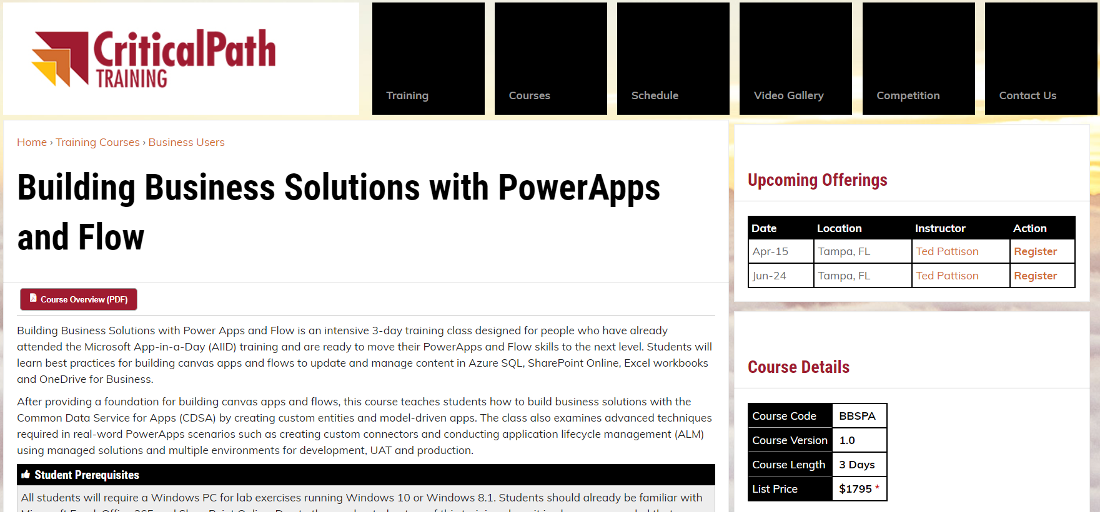
Our Newest PowerApps Training Course
Advanced PowerApps and Flow training
Designed for students who have already attended Microsoft's App-in-a-day
Three days filled with plenty of hands-on lab exercises
Learn advanced builder skills & best practices
More info at https://CriticalPathTraining.com

Slide 3
Agenda
Common Data Service for Apps Overview
Creating the CDSA Database
Understanding Entities
Creating Solutions
Building Model-driven Apps
Creating a Custom Entity

Slide 4
What is Common Data Service for Apps?
Platform for building business applications
Business application include CRMs, ERPs, etc.
Provides common infrastructure
What does CDS for Apps provide?
Standard database schema of common entities
Extensible design for extending and creating entities
Ability to build entity-specific UI components
Ability to build entity-specific business logic
Ability to build apps by assembling components

Slide 5
Evolution of Microsoft Business Application Suite
Microsoft has acquired many software companies
Several acquisitions involved software that targets CRM and ERP
Microsoft evolved many software applications into Dynamics suite
Dynamics 365 represents evolution from on-premises to cloud
Navision
Microsoft Dynamics NAV
Axapta
Microsoft Dynamics AX
Dynamics 365
Great Plains
Microsoft Dynamics GP
Solomon
Microsoft Dynamics SL
Microsoft CRM
Microsoft Dynamics CRM

Slide 6
Birth of a Platform
Microsoft is migrating infrastructure out of Dynamics 365
CDSA has infrastructure for building entity-based business solutions
Dynamics 365 is now collection of entities with UI and logic
Custom solutions can be built using entities with UI and logic
CDSA provides foundation of Microsoft Business Application Platform
Microsoft's Power platform
Dynamics 365
Custom Solution 1
Custom Solution 2
Common Data Service for Apps (CDSA)

Slide 7
Common Database Model Schema
CDM defines set of entities available to all applications
Account: represents an business entity that can be invoiced
Contact: represents a human being
Activity: represents an event that can be schedule
Task: represents work item that can be assigned to user or team
Email: represents email message sent or received
User: represents system user who can be owner of records
CDS for Apps
Account
Contact
Activity
Task
Email
User

Slide 8
CDS for Apps vs Dynamics 365 for Sales
CDS for Apps provides base set of entities
Custom solutions can extend and add entities
Dynamics 365 add a large set of its own entities
Dynamics 365 Value-added Entities
Territory
Lead
Opportunity
Quote
Invoice
Order
Product
Price
List
Discount
Contract
Service
Service
Activity
Case
Case Resolution
Campaign
Campaign
Activity
Campaign
Response
Competitor
CDS for Apps Entities
Account
Contact
Activity
Task
Email
User

Slide 9
Agenda
Common Data Service for Apps Overview
Creating the CDSA Database
Understanding Entities
Creating Solutions
Building Model-driven Apps
Creating a Custom Entity

Slide 10
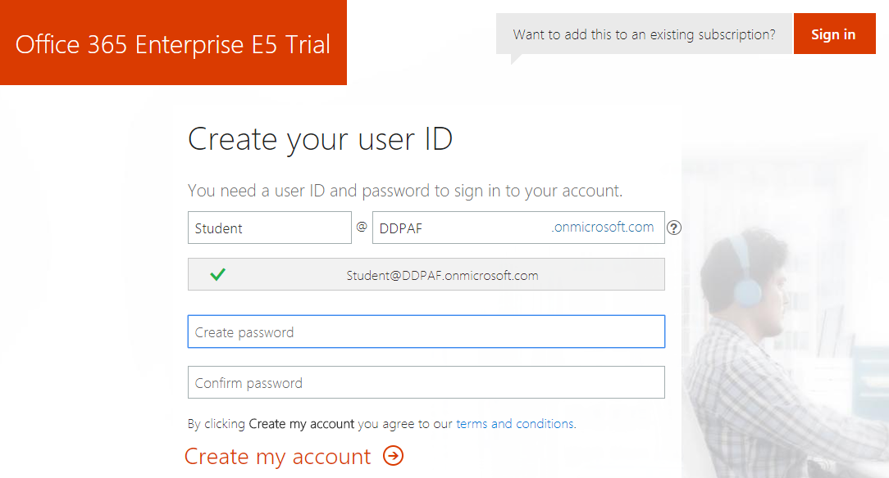
Creating an Office 365 E5 Trial Tenant
Test out CDSA by creating an Office 365 trial tenant
Provides an isolated development environment for testing
Trial accounts will last for 30 days
Use this link: https://go.microsoft.com/fwlink/p/?LinkID=698279&culture=en-US&country=US

Slide 11
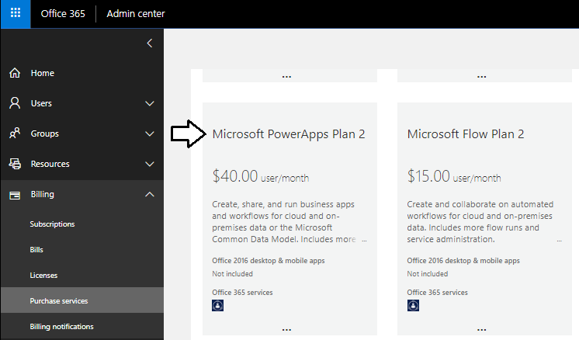
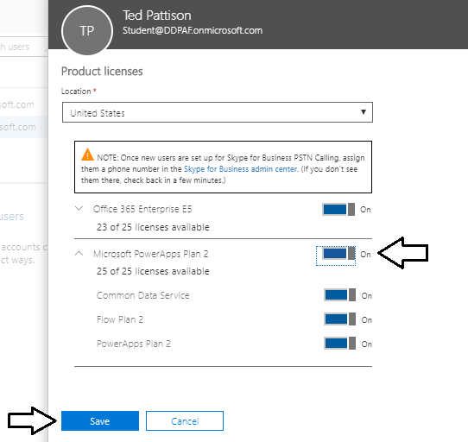
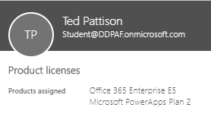
PowerApps Plan 2
Certain design tasks require PowerApps Plan 2
You can start a 30-day trial for PowerApps Plan 2
License must be assigned to individual user accounts

Slide 12
What is an Environment?
Environment is container for PowerApps, Flow and the CDS
Each environment and its resources exist within a geographic region
Environment resources include PowerApps, Flows and CDS database
Environment represents a governance and security boundary
Every tenant is provisioning with a default environment
Administrator can provision additional environments if needed
Environment can be provisioned with or without a CDS database
Environment can contain only one CDS database
Tenant A – Acme Corp
Tenant B – Mega Corp
Default Environment
POC Environment
Default Environment
Production Environment
Dev Environment
PowerApps & Flows
PowerApps & Flows
PowerApps & Flows
PowerApps & Flows
PowerApps & Flows
CDS
Database
CDS
Database
CDS
Database

Slide 13
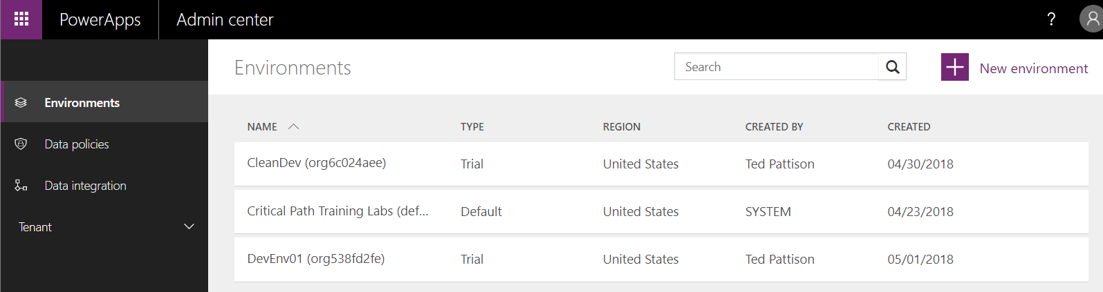
Environments and CDS for Apps
Environments managed in PowerApps Admin Center
You can configure security and access
You can create new environments
Access to environment controlled at 3 different levels
Environmental roles
Resource permissions for apps and flows
CDS Database roles

Slide 14
Environment Roles (Admin and Maker)
Environment Admin role
Change role membership
Create new environments with or without CDS database
View and manage all resources created in environment
Set Data Loss Prevention policies
Environment Maker role
Create apps, connections, custom APIs, gateways, and flows
Create and extend CDS entities (requires PowerApps plan 2)

Slide 15
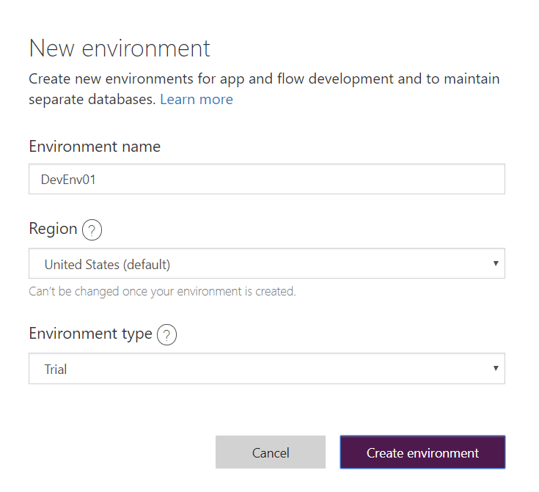
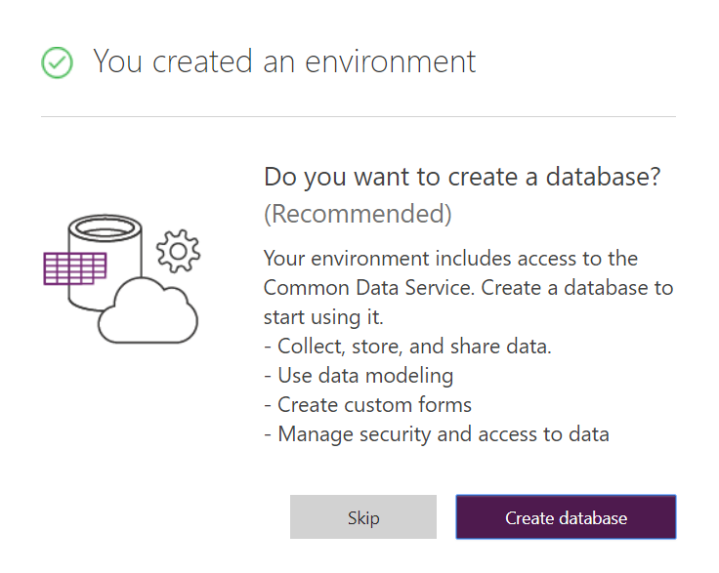
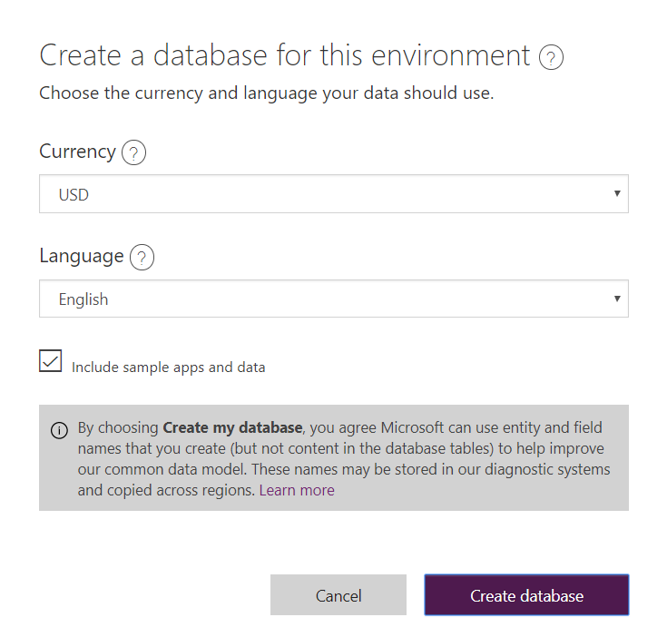
Creating the CDS for Apps Database
Steps to create a new CDS for Apps Database
Navigate to Power Apps Admin Center
Create a new environment
Configure the new environment with a CDS for Apps database
Add option to include sample data [Optional]

Slide 16
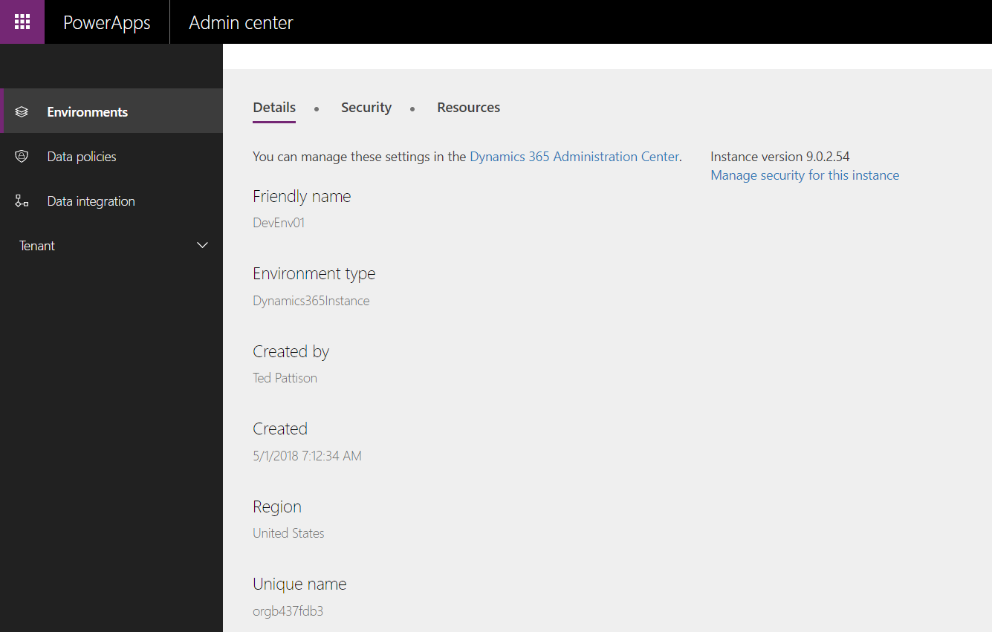
Examining the New Environment

Slide 17
Agenda
Common Data Service for Apps Overview
Creating the CDSA Database
Understanding Entities
Creating Solutions
Building Model-driven Apps
Creating a Custom Entity

Slide 18
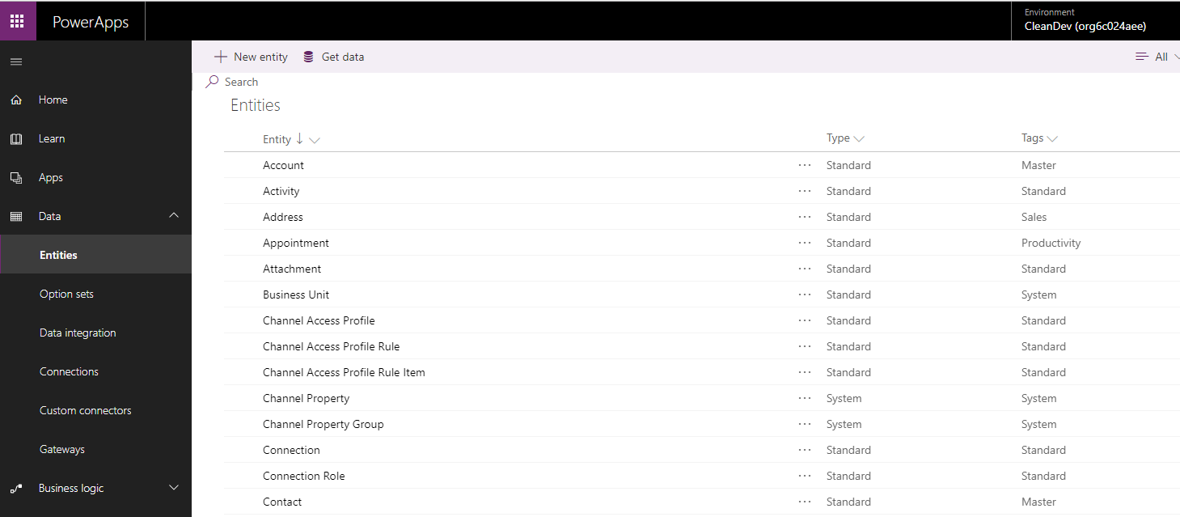
Inspecting the Standard Entities

Slide 19
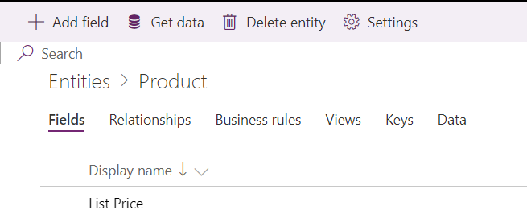
Importing Data
You can import data from external sources
Data can be added to table for new or existing entity
Importing tools include Power Query in the browser

Slide 20
Agenda
Common Data Service for Apps Overview
Creating the CDSA Database
Understanding Entities
Creating Solutions
Building Model-driven Apps
Creating a Custom Entity

Slide 21
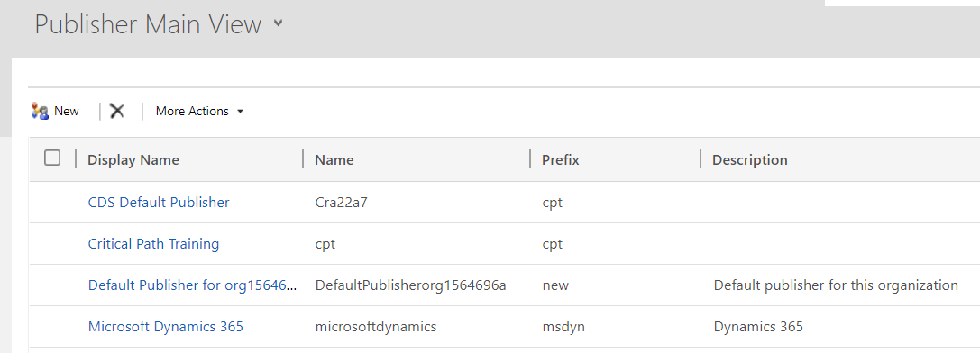
Publishers and Solutions
CDSA solutions used to distribute applications
Provides means to conduct ALM
CDSA Publishers
Profile used to provide identity for CDSA solutions
You should create new publisher when distributing solutions

Slide 22
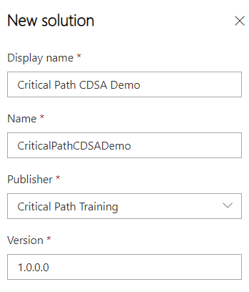
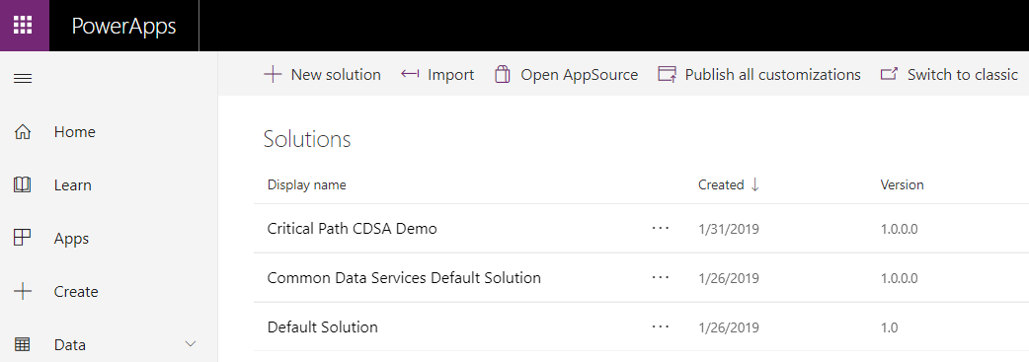
Creating a New CDSA Solution

Slide 23
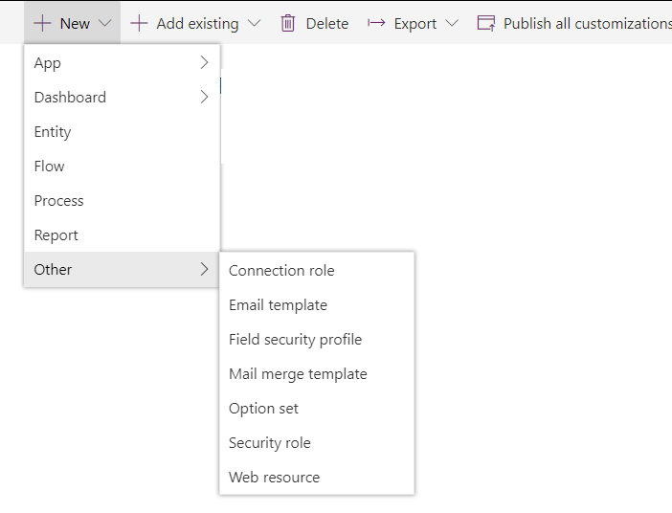

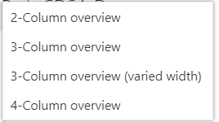
Adding Solution Components

Slide 24
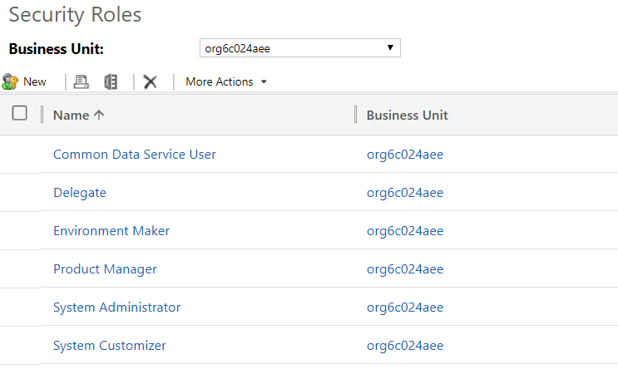
CDSA Security Roles
User access to CDS data based on roles
Environment security configured in terms of business units
CDS pre-defines common security roles
You can define custom security roles as well

Slide 25
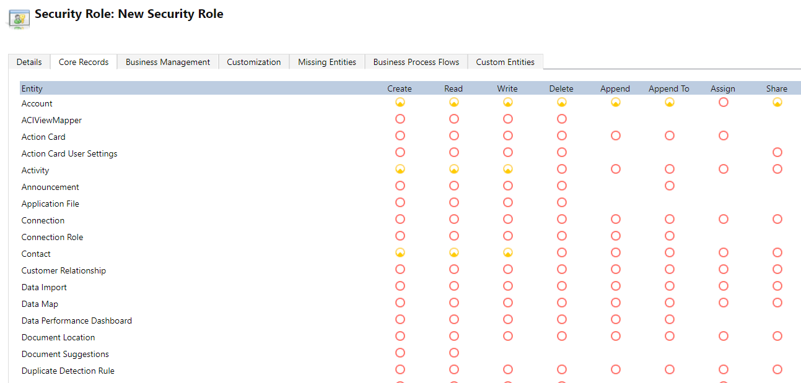
Security Role Configuration – Core Records
Roles define access to specific entities
Permissions include create, read, write, delete, etc.

Slide 26
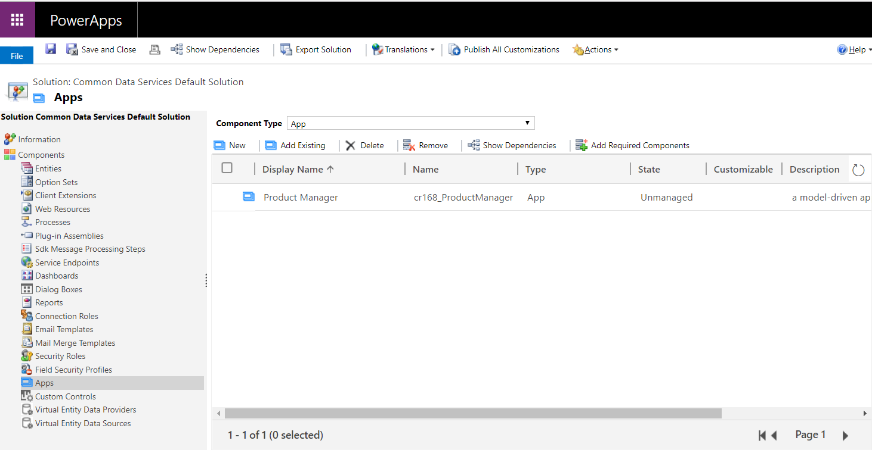
Solution Explorer
Solution Explorer provides top-level view of customizations
Can be challenging to find in current UI experience

Slide 27
Agenda
Common Data Service for Apps Overview
Creating the CDSA Database
Understanding Entities
Creating Solutions
Building Model-driven Apps
Creating a Custom Entity

Slide 28
Moving to Model-driven Apps
What are the key benefits of model-driven apps?
Rich no-code design environment focusing on components
Create apps with consistent UI navigation, elements & metaphors
Design apps using the building blocks of Dynamics 365
Create responsive apps that work on desktop and mobile devices
Build apps into solutions that can be distributed and versioned
What are the steps to building a model-driven app?
Model business data using CDSA entities
Add and customize forms and views to create UI experience
Add business rules and business process flows with business logic

Slide 29
Creating Model-driven Apps

Slide 30
Agenda
Common Data Service for Apps Overview
Creating the CDSA Database
Understanding Entities
Creating Solutions
Building Model-driven Apps
Creating a Custom Entity

Slide 31
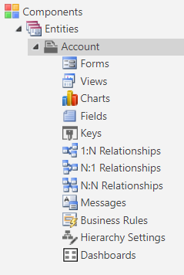
What Exactly is an Entity?
Data components
Entity, Fields, Option sets, Relationships
UI components
Forms
Views
Logic Components
Business rules
Business process flows
Workflows, Actions & Flows
Visualization Components
Charts
Dashboards
Power BI components

Slide 32
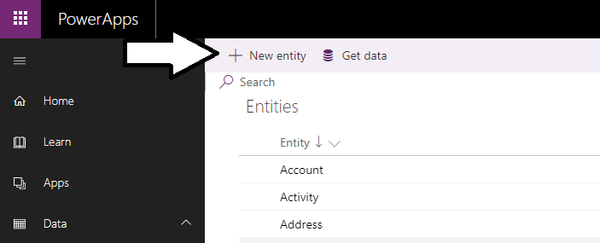
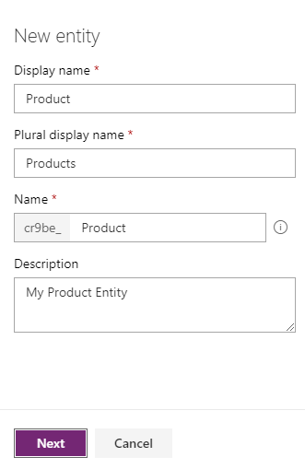
Creating a Custom Entity

Slide 33
Data Components
Entity
Field
Option set field
Relationship

Slide 34
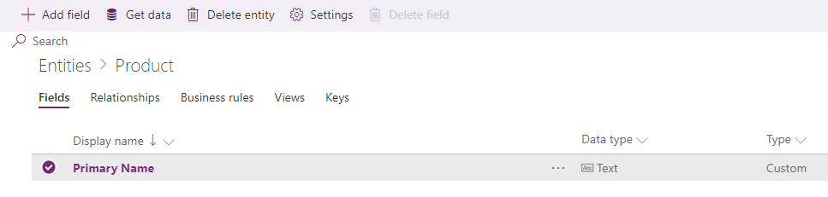
Primary Name
Every entity created with Primary name field
Display name can be changed to something more appropriate

Slide 35
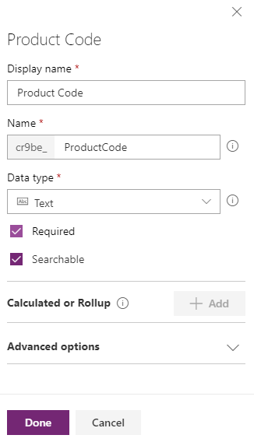
Adding Fields
Custom entity can be extended by adding fields

Slide 36
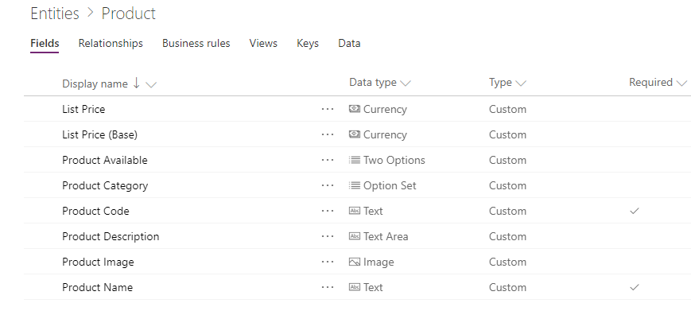
Adding Custom Fields

Slide 37
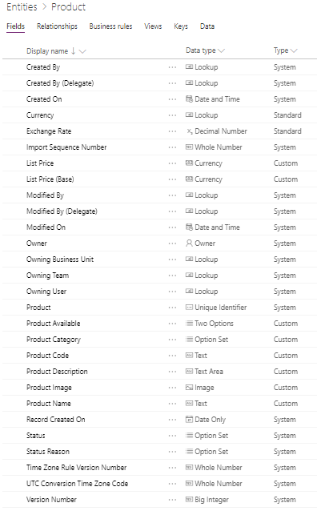
Core System Fields Added to All Entities

Slide 38
UI Components
App
Top-level collection of components
Tracks fundamental app properties, client type, and app URL
Site map
Provides navigation across other UI components
Form
Provides set of data-entry fields for a specific entity
View
Read-only view of records for a specific entity
Defines display columns, column width, sort behavior and filters

Slide 39
Logic Components
Business rule
Logic to define rule or validation constraints to a form
Business process flow
Interactive logic to walk user through standard business process
User moves flow from step to step until flow completes
Workflow
Non-interactive logic to automate business process
Once workflow starts, it runs to completion without user interaction
Actions
Logic that can be invoked manually by user
Flow
Microsoft Flow logic to read or write data to external sources

Slide 40
Summary
Common Data Service for Apps Overview
Creating the CDSA Database
Understanding Entities
Creating Solutions
Building Model-driven Apps
Creating a Custom Entity

